Slide 1
AIS Vessels Traffic Data
Ravi Shankar
01647513

Slide 2
Data Set:
AIS Vessels Traffic Data: Is large amount of the trajectory data for the ships,
Data is taken from their webpage Marine Cadastre – Vessels traffic data, available here on the following webpage
https://marinecadastre.gov/ais/
Data is divided into a hierarchy of Year, and sub hierarchy of Zones and by Month, even available the full years data to download. Data contains the Vessels Information, Broadcast points and the Voyages information.

Slide 4
Initial Work and Analysis
Initial Goal is to find out the stops from the trajectory dataset, to segment the trajectory into multiple sub trajectories.
So, in the starting I worked on the single Vessel Data.
Later on I worked on three months data, which contains around 54582842 records.
The analysis is to clean the dirty data and to remove the outliers, to get the right path.

Slide 5
Calculation and find Sub Trajectories
To find out stops, I followed some basic steps.
1- First I sorted out the whole Data on the Basis of MMSI(represents the Vessels) and BaseDateTime(Date and Time)
2- Calculated the Distance through the given latitude and longitude value, and calculated the total hours through the given BaseDateTIme
3- Calculated Speed through the Given hours and Distance.
4- then Calculated the stops through the speed, if the speed goes below some threshold, it will segment the trajectory into sub trajectories.

Slide 6
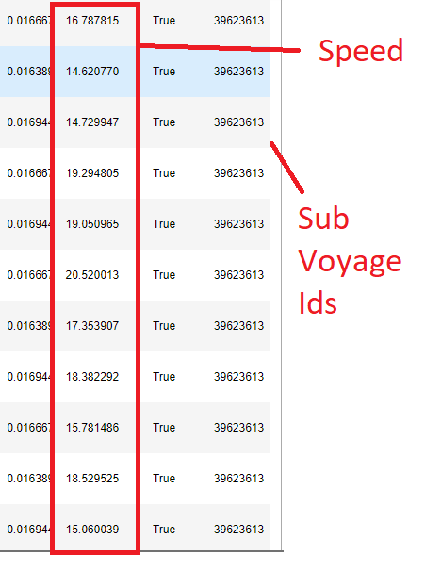
Results:
Speed threshold greater than 5
Separating through different SubVoyageIDs

Slide 7
Scalability
As a part of Scalability, I used the PySpark python to improve the performance for the calculation.
As I did the same work in Pandas it took little more time than PySpark
In comparison Pandas took 4.3 minutes to run and for the Same code PySpark took 2.83 minutes.

Slide 8
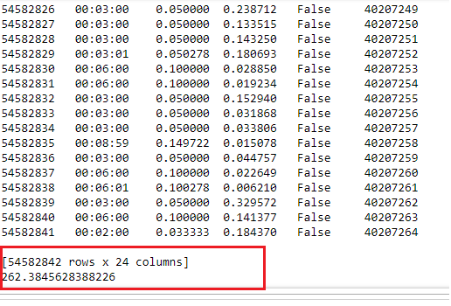
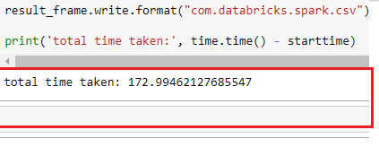
Pandas Vs PySpark
Comparison between PySpark and pandas performance

Slide 9
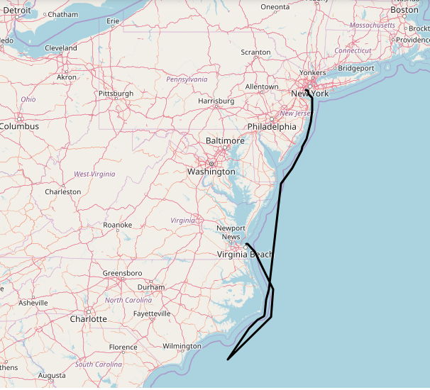
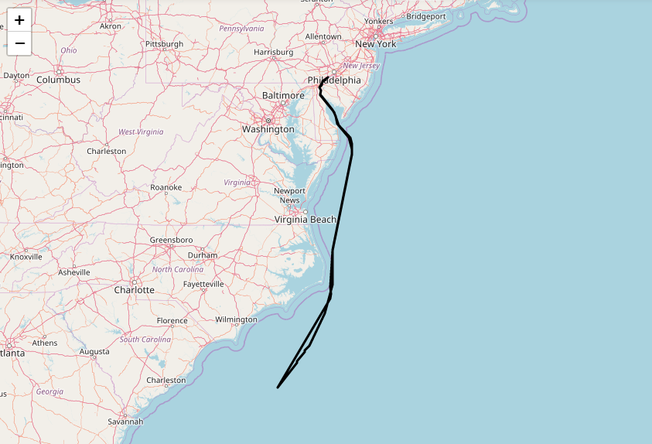
Plotting the Sub Trajectory

Slide 10
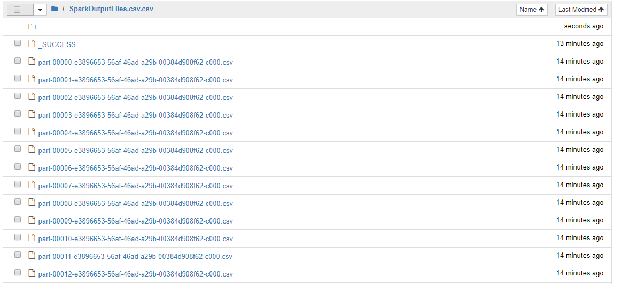
Spark Files output into multiple files

